Slide 1
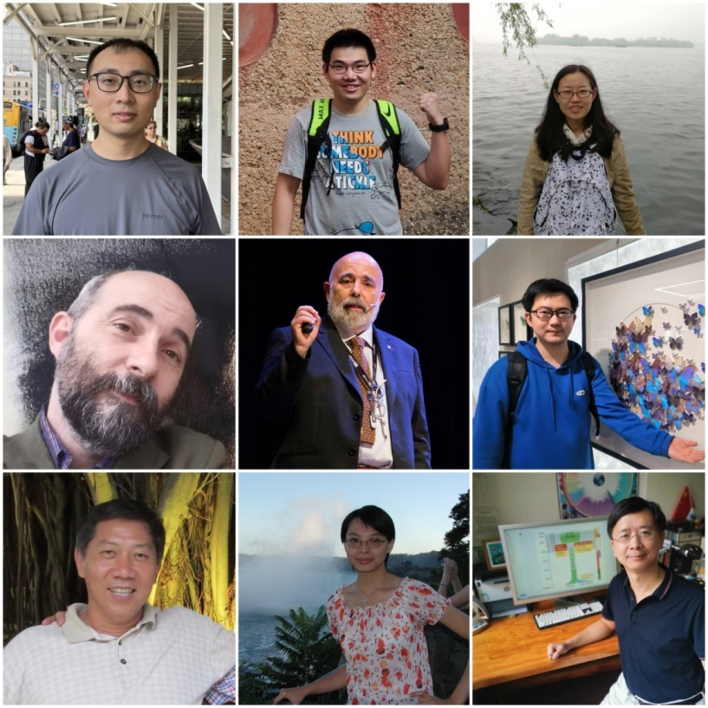
Original version. Last modified by the authors on September 09, 2023
Genomic inference of a severe human bottleneck
during the Early to Middle Pleistocene transition
The slides were prepared by
Fabio Di Vincenzo, University of Florence
Giorgio Manzi, Sapienza University of Rome
Yi-Hsuan Pan, Key Laboratory of Brain Functional Genomics, East China Normal University
Haipeng Li, Shanghai Institute of Nutrition and Health, CAS.
The slides can be freely shared, re-distributed and modified. To avoid the mis-understanding, the modified slides should be properly marked. The paper can be downloaded via the link:
https://www.science.org/doi/10.1126/science.abq7487
Please include this link when sharing the slides and discussing the related questions online.
Wangjie Hu
Ziqian Hao
Pengyuan Du
Fabio Di Vincenzo
Giorgio Manzi
Jialong Cui
Yun-Xin Fu
Yi-Hsuan Pan
Haipeng Li

Slide 2
Hominin evolution during the last 4 million years
H. sapiens
H. rhodesiensis
Denisovans
H. erectus
Chimpanzee
0
H. naledi
H. floresiensis
1
P. robustus
H. neanderthalensis
H. antecessor
H. ergaster
H. habilis
P. boisei
2
A. sediba
Million years ago
Dmanisi
H. rudolfensis
P. garhi
H. heidelbergensis
3
Ledi Geraru
A. afarensis
P. aethiopicus
K. platyops
A. africanus
4
A. bahrelghazali
A. deyiremeda
A. anamensis
Homo
Australopithecus
Paranthropus
Modified from de Sousa, et al. (2023) Communications Biology 6:636
Source: pixabay.com

Slide 3
The last one million years essential for the emergence of humans
H. sapiens
H. rhodesiensis
Denisovans
H. erectus
Chimpanzee
0
H. naledi
H. floresiensis
1
P. robustus
H. neanderthalensis
H. antecessor
H. ergaster
H. habilis
P. boisei
2
A. sediba
Million years ago
Dmanisi
H. rudolfensis
P. garhi
H. heidelbergensis
3
Ledi Geraru
A. afarensis
P. aethiopicus
K. platyops
A. africanus
4
A. bahrelghazali
A. deyiremeda
A. anamensis
Homo
Australopithecus
Paranthropus
Modified from de Sousa, et al. (2023) Communications Biology 6:636
Source: pixabay.com

Slide 4
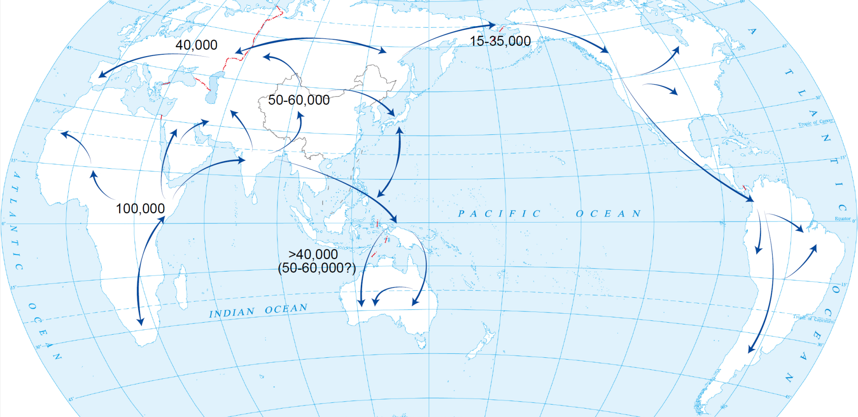
Well-known human population size changes in the last 100 thousand years
Data from Luca Cavalli-Sforza & Feldman (2003) Nature Genet
审图号 GS(2016)2962号

Slide 5
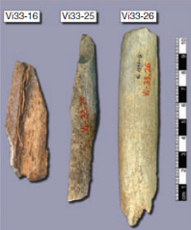
Ancient DNA of Neanderthals in Europe
dated 38 – 44 thousand years ago
Ancient DNA of African human ancestors
dated 300 thousand years ago?
Green et al. (2010) Science 328:710-722
审图号：GS(2020)4391号

Slide 6
A new method needed
to infer population size history one million years ago
(Analogous to the effective range of a gun)
(0.1 million years)
100m
(1 million years)
1,000m

Slide 7
Coalescent tree / evolutionary tree
The most recent common ancestor (MRCA)
thousands years ago
t
2
Backward in time
t
3
t
4
t
at present
5

Slide 8
Coalescent tree / evolutionary tree
The most recent common ancestor (MRCA)
thousands years ago
t
2
Backward in time
t
3
t
4
t
at present
5
Singleton mutations (n = 7)
Doubleton mutations (n = 4)
Tripleton mutations (n = 1)

Slide 9
How to infer population size history from SFS (1)
UK samples
3 individuals (or 6 genomes)
Site frequency spectrum (SFS)
Obs. SFS
Expected values
Model 01 for
population size history
Number of mutations
singletons
Observed number of doubletons
Exp. SFS
Population size
SFS types
Present
Past
The model was rejected because expected SFS and observed SFS are un-matched.

Slide 10
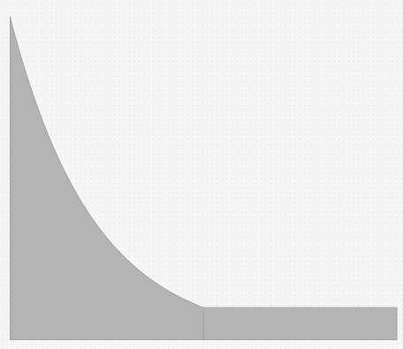
How to infer population size history from SFS (2)
UK samples
3 individuals (or 6 genomes)
Site frequency spectrum (SFS)
Obs. SFS
Expected values
Model 02 for
population size history
Number of mutations
singletons
Observed number of doubletons
Exp. SFS
Population size
SFS types
Present
Past
The model was accepted because expected SFS and observed SFS are perfectly matched.

Slide 11
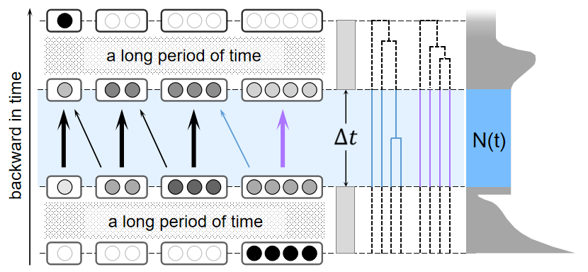
Fast infinitesimal time coalescent process (FitCoal)

Slide 12
The expected branch length $BL_{i}(N(⋅))$ of type $i$
$$\sum_{l=2}^{n−i+1}{\int_{0}^{∞}{2}}N(t)p_{l}(t)ldt\frac{\left({n−i−1 \atop l−2}\right)}{\left({n−1 \atop l−1}\right)}$$
$$N(t)$$
: The effective population size at time t
: The probability of state l at time t
: The number of chromosomes sampled
$$p_{l}(t)$$
$$n$$

Slide 13
Composite likelihood function
$$L_{μ,ι}(\overset{⃗}{ξ},N(⋅))=\prod_{i=1}^{n−1}{\frac{λ_{i}^{ξ_{i}}e^{−λ_{i}}}{ξ_{i}!}}$$
$\overset{⃗}{ξ}=(ξ_{i})$: The observed site frequency spectrum
$ξ_{i}$ : The number of mutations of the same size i in the sample
$N\left(⋅\right)$: The population size history
$λ_{i}$ : $μσBL_{i}(N(⋅))$
$σ$: The length of sequences

Slide 14
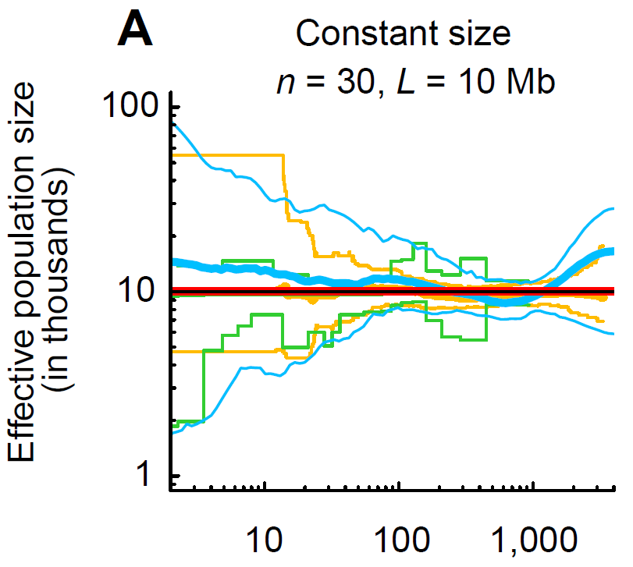
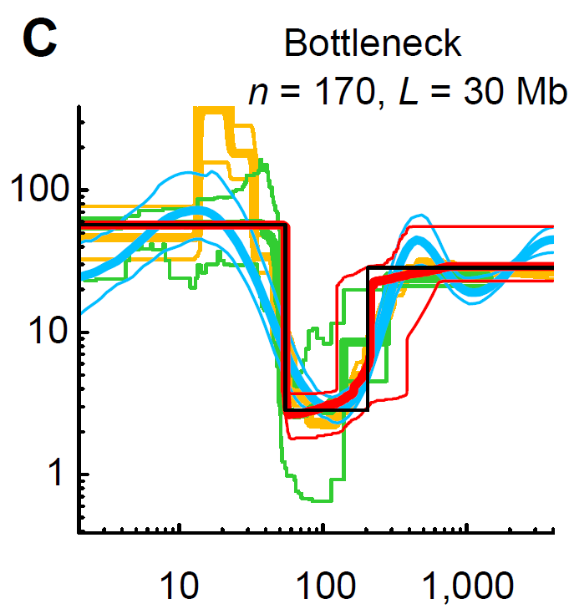
Population size histories inferred by
FitCoal, PSMC, Stairway Plot, and SMC++ using simulated samples
Time (thousand years ago)
Time (thousand years ago)
Li & Durbin (2011) Nature
Liu & Fu (2015) Nature Genet
Terhorst et al. (2017) Nature Genet

Slide 15
Public population genomic data set (1)
1000 Genomes Project (1000GP)
7 African populations, and 19 non-African populations
172 – 226 genomic sequences per population
Low coverage in non-coding regions (~5X)
审图号 GS(2016)2962号
Sampling locations adopted from Altshuler, et al. (2015) Nature

Slide 16
Public population genomic data set (2)
HGDP-CEPH
3 African populations, and 21 non-African populations
32 - 92 genomic sequences per population
High coverage (~35X)
审图号 GS(2016)2962号
Sampling locations adopted from Bergstrom et al. (2020) Science

Slide 17
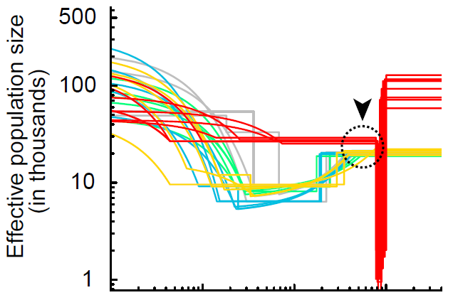
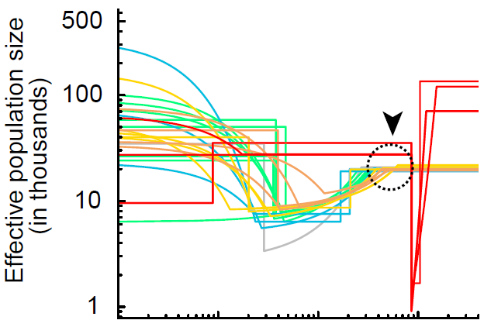
African population size history
1000GP
HGDP-CEPH
African
European
Middle East
East Asian
South Asian
American
1,270
1,300
“Ancient population survey”

Slide 18
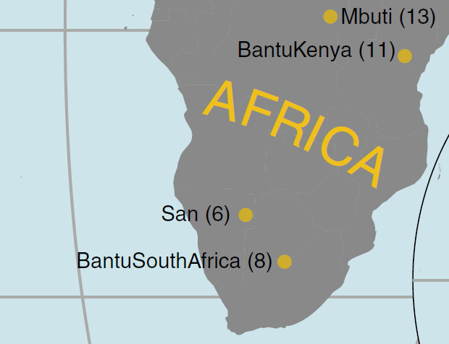
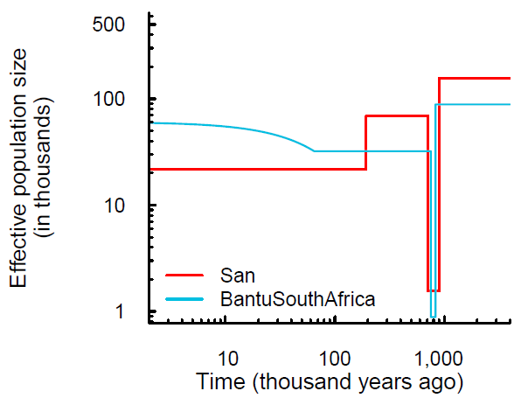
FitCoal-inferred population size histories of small African samples
Bergstrom et al. (2020) Science

Slide 19
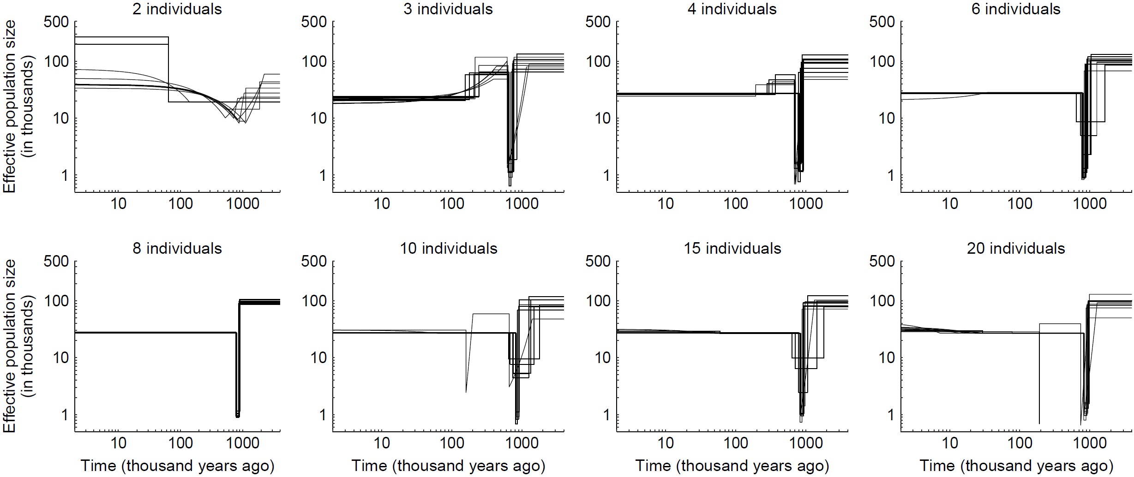
FitCoal-inferred population size histories of African (YRI) subsamples
YRI: Yoruba in Ibadan, Nigeria
审图号：
GS(2020)4391号

Slide 20
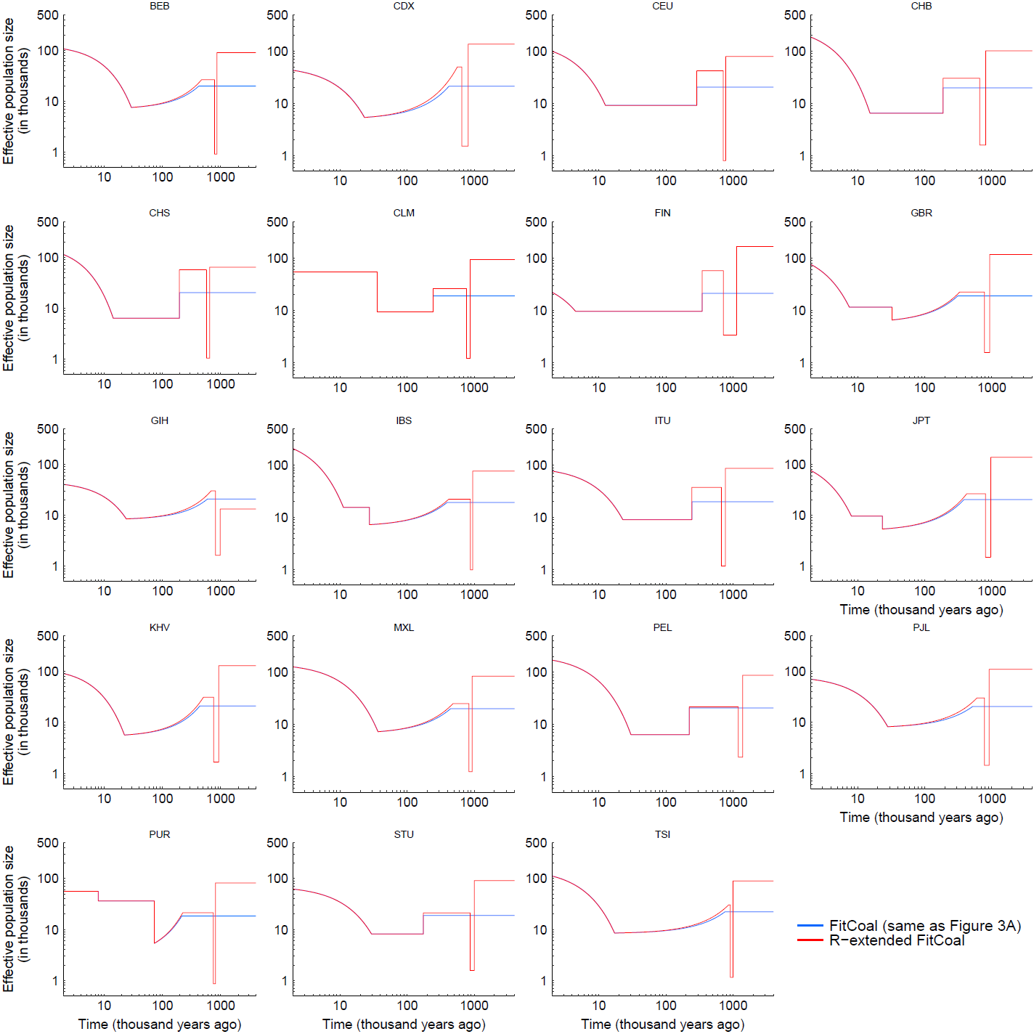
The ancient severe bottleneck detected in 19 non-African populations
in 1000GP using R-extended FitCoal
Ancestral Ne
103,390 vs 98,130
Start time of the bottleneck
(in thousand years BP)
921 vs 930
Ne during the bottleneck
1,450 vs 1,280
End time of the bottleneck
(in thousand years BP)
785 vs 813
(non-African vs African)

Slide 21
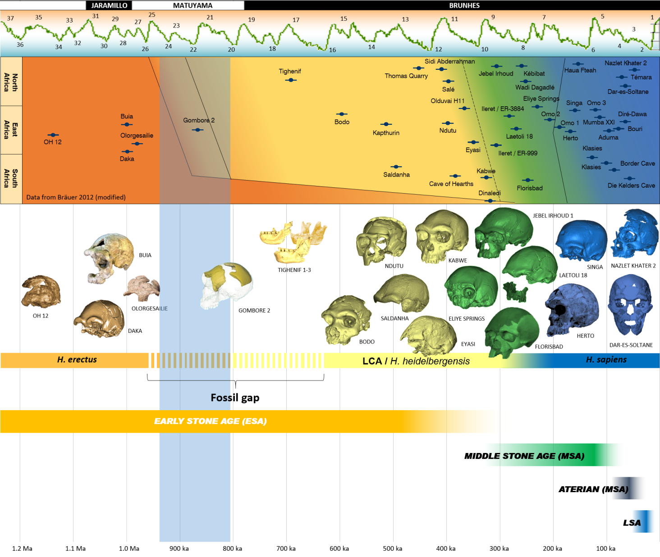
The severe bottleneck congruent with the African fossil gap
The duration of the ancient severe bottleneck

Slide 22
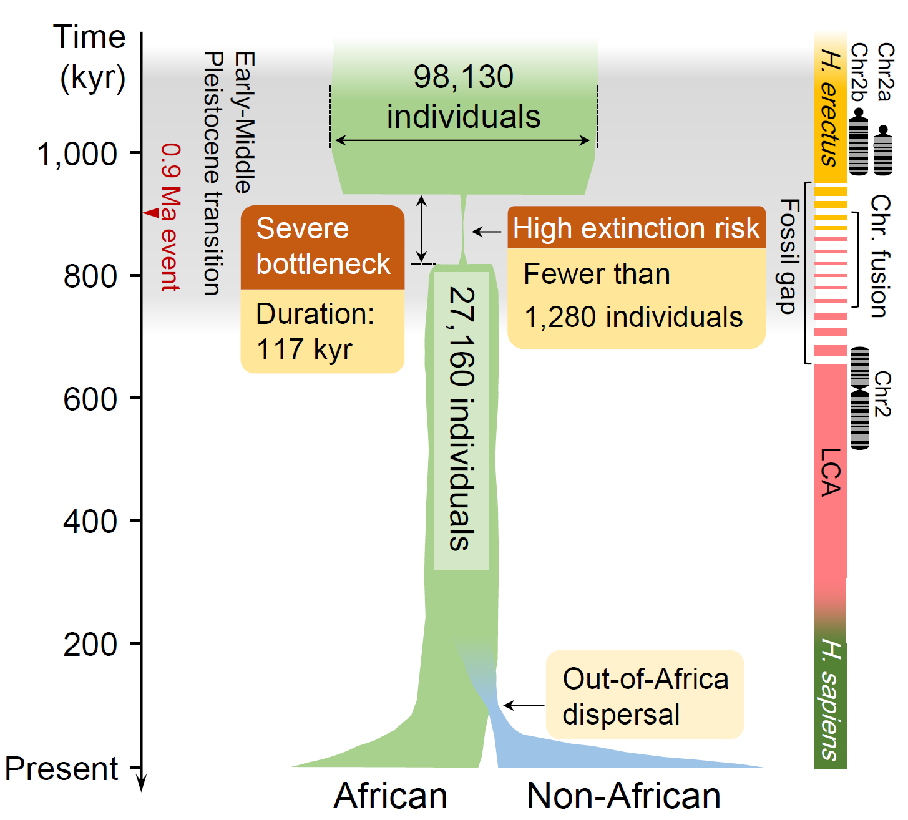
Summary (1)
LCA: the last common ancestor shared by Denisovans, Neanderthals, and modern humans

Slide 23
Summary (2)
It’s a 10-year project, most of our time is to develop FitCoal and validate the bottleneck
~ one year
~ six months
~ one year
The first version of
the theory and
software (discarded)
The second version of
the theory and
software (useful)
FitCoal
~ six months (Most efforts were paid to identify “errors”)
Data analysis
(1000GP and HGDP-CEPH)
and confirm the results
Download VCF
Calculate SFS
Infer pop size history
Debug program
~ seven years (Validation for the ancient severe bottleneck)
Cross
check
Obs. vs
expected
SFS
Africa
vs
nonAfrica
Reviewer
extended
FitCoal
Ancient
introgress.
Min-
sample
FitCoal
vs
Z.W.
FitCoal
vs
other four
Selection
Population
structure
African fossil gap
Climate changes & 0.9 Ma event
Control of fire
Speciation
Chromosome fusion

Slide 24
Summary (3)
It’s a 10-year project, most of our time is to develop FitCoal and validate the bottleneck
All modern humans are the descendants of the ancient small population
There were about 1,280 human breeding ancestors lived 900 thousand years ago.
The ancient severe bottleneck was likely caused by climate changes
Our ancestors may be united to fight against harsh environments and have succeeded
The ancient severe bottleneck may have accelerated the evolution of human ancestors and the speciation process, and thus make us unique to other archaic hominins
Molecular clock does not change the existence of the ancient severe bottleneck
It is important for population genetics and paleontologists to collaborate in the future

Slide 25
Why us?
1) Our team is highly efficient, and we act as one.

Slide 26
Why us?
1) Our team is highly efficient, and we act as one.
2) The analytical formulae of the expected branch lengths are obtained, and computational accuracy reaches .
${10}^{−8}$ or ${10}^{−11}$
0.1
Number of mutations
Expected number of mutations (Model 2)
Expected branch lengths (Model 2)
0.05
Observed number of mutations
SFS types
SFS types

Slide 27
Why us?
1) Our team is highly efficient, and we act as one.
2) The analytical formulae of the expected branch lengths are obtained, and computational accuracy reaches .
3) FitCoal treats both recent and ancient time fairly.
${10}^{−8}$ or ${10}^{−11}$
Present
Past
E=MC²
E=MC²
FitCoal
No pre-defined time blocks, unbiased for the inference of recent and ancient history
PSMC (Li & Durbin, Nature 2011, Vol 475:493-496), SMC++ (Terhorst et al., Nature Genet 2016, Vol 49:303-309)
Short time blocks, friendly for recent history inference
Long time blocks, un-friendly for ancient history inference

Slide 28
Why us?
1) Our team is highly efficient, and we act as one.
2) The analytical formulae of the expected branch lengths are obtained, and computational accuracy reaches .
3) FitCoal treats both recent and ancient time fairly.
4) Both exponential and instantaneous changes are allowed within each inference time interval of FitCoal.
${10}^{−8}$ or ${10}^{−11}$

Slide 29
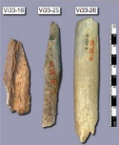
Why us?
1) Our team is highly efficient, and we act as one.
2) The analytical formulae of the expected branch lengths are obtained, and computational accuracy reaches .
3) FitCoal treats both recent and ancient time fairly.
4) Both exponential and instantaneous changes are allowed within each inference time interval of FitCoal.
5) We focused on present-day human genomic sequences, instead of Neanderthals.
${10}^{−8}$ or ${10}^{−11}$
Genomic sequences of humans
(1,000 thousand years)
(~960 thousand years)
Genomic sequences of Neanderthals
(dated 38 – 44 thousand years ago)

Slide 30
How to cite and download the paper
How to cite:
Wangjie Hu, Ziqian Hao, Pengyuan Du, Fabio Di Vincenzo, Giorgio Manzi, Jialong Cui, Yun-Xin Fu, Yi-Hsuan Pan, Haipeng Li (2023) Genomic inference of a severe human bottleneck during the Early to Middle Pleistocene transition. Science 381, 979-984.
How to download the paper:
For most researchers, it can be obtained via https://www.science.org/doi/10.1126/science.abq7487
A free published paper can be obtained by visiting Dr. Yi-Hsuan Pan’s website (https://faculty.ecnu.edu.cn/_s14/pyx_en/main.psp). Click Academic Achievements, and search “severe human bottleneck”. You should be able to find a link to download the published paper for free. The free link is provided by the journal (with a author token), so please DO NOT share the link publicly. It can only be accessed by visiting Dr. Yi-Hsuan Pan’s website.
Green open access (the accepted manuscript) is also available (with permission of the AAAS) via https://www.researchgate.net/publication/373553749_Genomic_inference_of_a_severe_human_bottleneck_during_the_Early_to_Middle_Pleistocene_transition

Slide 31
Acknowledgement
We would thank the following funders: National Natural Science Foundation of China, Chinese Academy of Sciences, National Key Research and Development Project, National Institutes of Health, Education Bureau of Jinan and Shandong First Medical University, Key Laboratory of Brain Functional Genomics at East China Normal University, Shanghai Institute of Nutrition and Health, China Postdoctoral Science Foundation, Shandong Provincial Natural Science Foundation, and Shandong Provincial Postdoctoral Innovation Talent Support Program.

